Slide 1
FINIX / INVESTIGATION INTELLIGENCE
Evidence-backed investigation
FiniX — UPI Fraud-Ring & Merchant Intelligence
From fragmented payment data to explainable investigation intelligence
20K
36.1K
6.2K
2.8K
27.9K
transactions
KYC records
merchant records
chargebacks
network nodes

Slide 2
01 / THE INVESTIGATION QUESTION
Fraud signals rarely live in one transaction
Trace the investigation path across people, payments, merchants, complaints, and the wider network.
01
02
03
04
05
USER
TRANSACTION
MERCHANT
CHARGEBACK
NETWORK
Who needs review?
What happened?
Where did it happen?
What was disputed?
What are they connected to?
Who needs review? Why? What are they connected to?
FRAME / PRODUCT CASE STUDY
02

Slide 3
02 / INVESTIGATION LAYER
FiniX turns messy payment data into explainable investigation
01
02
03
04
Data rescue
Analytics
Investigation
AI copilot
Cleaning, standardization, and validation.
Feature engineering plus KYC and merchant summarization.
Linkage evidence, risk signals, and network intelligence.
Optional Gemini explanation grounded in verified evidence.
Operating principle. Evidence first. Explanation follows verified evidence.
FRAME / PRODUCT CASE STUDY
03

Slide 4
03 / SOURCE SYSTEMS
Four source systems become one investigation layer
SOURCE 01
SOURCE 02
SOURCE 03
SOURCE 04
20,000
36,122
6,198
2,800
UPI transactions
KYC records
Merchant master
Chargebacks
Cleaned rows
Cleaned rows
Cleaned rows
Cleaned rows
RELATIONSHIP KEYS
RELATIONSHIP KEYS
RELATIONSHIP KEYS
user_id
merchant_id
txn_id
Connects the person.
Connects the business.
Connects the event.
FRAME / PRODUCT CASE STUDY
04

Slide 5
04 / DATA QUALITY
Clean the data. Preserve the evidence.
EVIDENCE CHECK | BEFORE | AFTER | DISPOSITION
Transaction rows | 20,400 raw | 20,000 cleaned | 400 exact duplicates removed
Missing UTR | 1,024 | 1,000 | Retained in evidence
Missing MCC | 2,926 | 2,872 | Retained in evidence
Validation | 90 checks | 21 warnings | Warnings retained
Negative transactions remain visible as investigation signals, not automatic fraud classifications.
FRAME / PRODUCT CASE STUDY
05

Slide 6
05 / FEATURE ENGINEERING
Rows become behavioural signals
Four compact evidence groups keep the investigation readable instead of producing a feature dump.
TRANSACTION LAYER
KYC + CHARGEBACK LAYER
Status, value, and frequency
Identity and case context
Status flags; high-value threshold at the 95th percentile; transaction counts; user-level amount anomaly using absolute z-score ≥ 2.5.
Age and status consistency, risk segments, severity, delays, open cases, and unauthorized-transaction flags.
MERCHANT LAYER
READING RULE
Business context
Signal, not verdict
Merchant age, active or suspended status, ticket-size context, and missing-MCC checks.
Each feature adds context to an evidence-backed investigation and a requires review decision.
FRAME / PRODUCT CASE STUDY
06

Slide 7
06 / LINKAGE EVIDENCE
Chargeback linkage is evidence, not a blind join
2,800 chargebacks produce 2,800 linkage records. One complaint stays one row; transaction-level data stays one row.
For each txn_id, compare chargeback user_id, transaction user_id, merchant_id values, disputed amount, and user–merchant connectivity.
COMPARE | EVIDENCE | COMPARE | WHY IT MATTERS
txn_id | Chargeback record | Transaction record | Preserves event identity
user_id | Chargeback user | Transaction user | Tests identity alignment
merchant_id | Chargeback merchant | Transaction merchant | Tests relationship alignment
Amount | Disputed amount | Transaction amount | Tests value consistency
STATUSES
STATUSES
STATUS
MISSING_TXN_ID · UNMATCHED_TRANSACTION
IDENTITY_MISMATCH · RELATIONSHIP_MISMATCH
MATCHED_IDENTITIES
FRAME / PRODUCT CASE STUDY
07

Slide 8
07 / INVESTIGATION PRIORITY
Multiple signals create an investigation priority
SIGNAL COUNT
SIGNAL COUNT
SIGNAL COUNT
0
1–2
3+
LOW
WATCH
ELEVATED_REVIEW
No observed signal count.
Requires review in context.
Multiple observed signals.
Example signals. High transaction frequency, high chargeback activity, identity mismatch, disconnected relationship, rejected or high-risk KYC, and unauthorized-transaction chargeback.
An investigation priority is not a fraud verdict.
FRAME / PRODUCT CASE STUDY
08

Slide 9
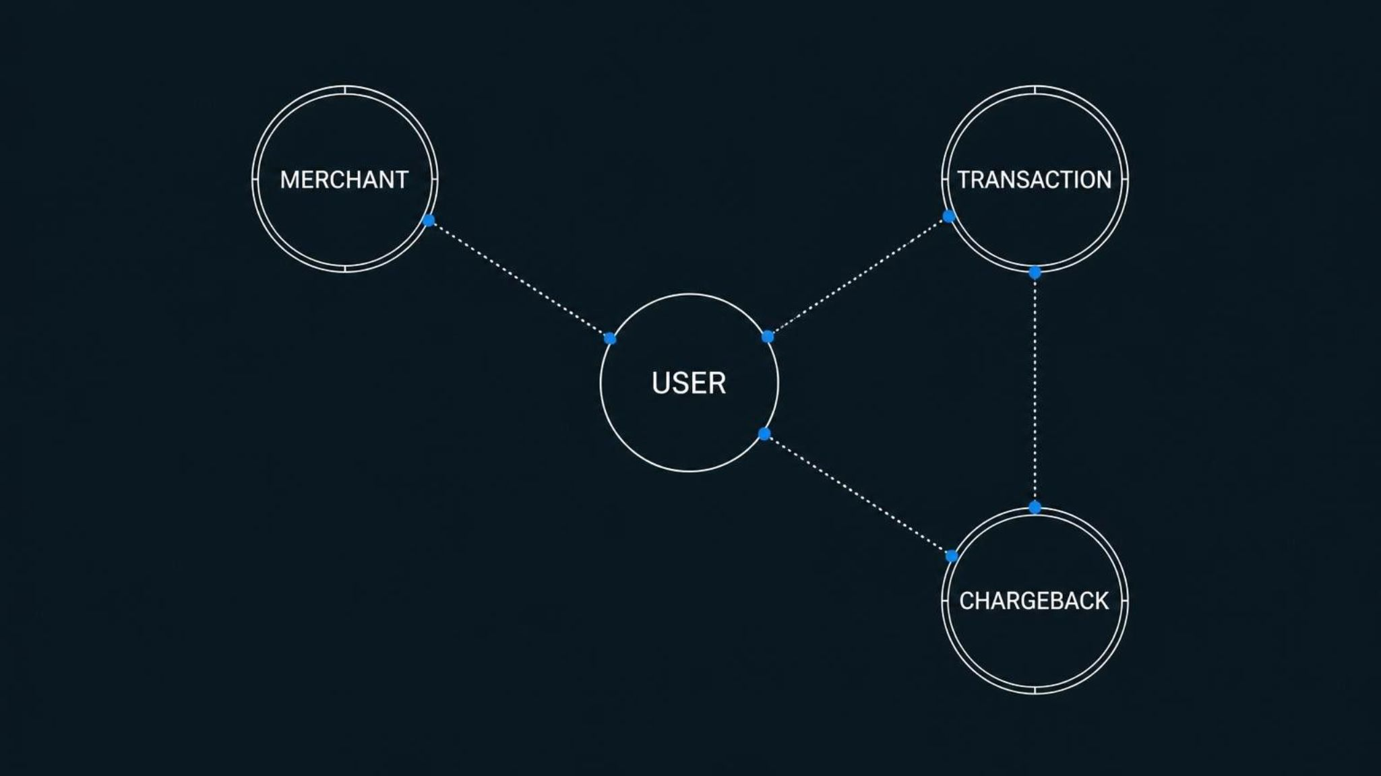
08 / NETWORK INTELLIGENCE
Move from rows to relationships
27,924
nodes
22,795
edges
Network structure helps investigators examine connected entities and disconnected relationships.
FRAME / PRODUCT CASE STUDY
09

Slide 10
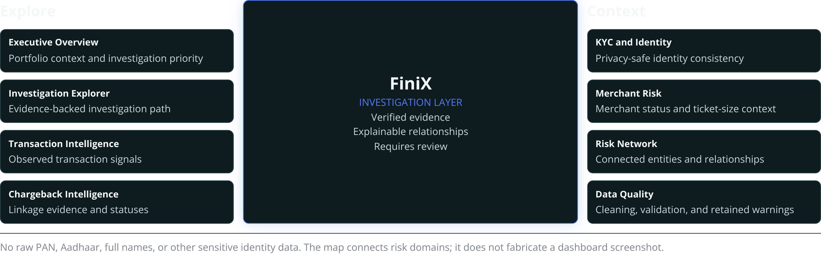
09 / PRODUCT MAP
One dashboard, multiple risk domains
A labeled product map shows how eight Streamlit pages work together without exposing sensitive identity data.

